Slide 1
Creating an Indoor Air Quality Standard
Notes:
Have been working on creating an IAQ standard through legislation. This past session it did not get out of committee because the fiscal note was so high. MPEC has members at hundreds of worksites across Maryland, many of which have indoor air quality issues.

Slide 2
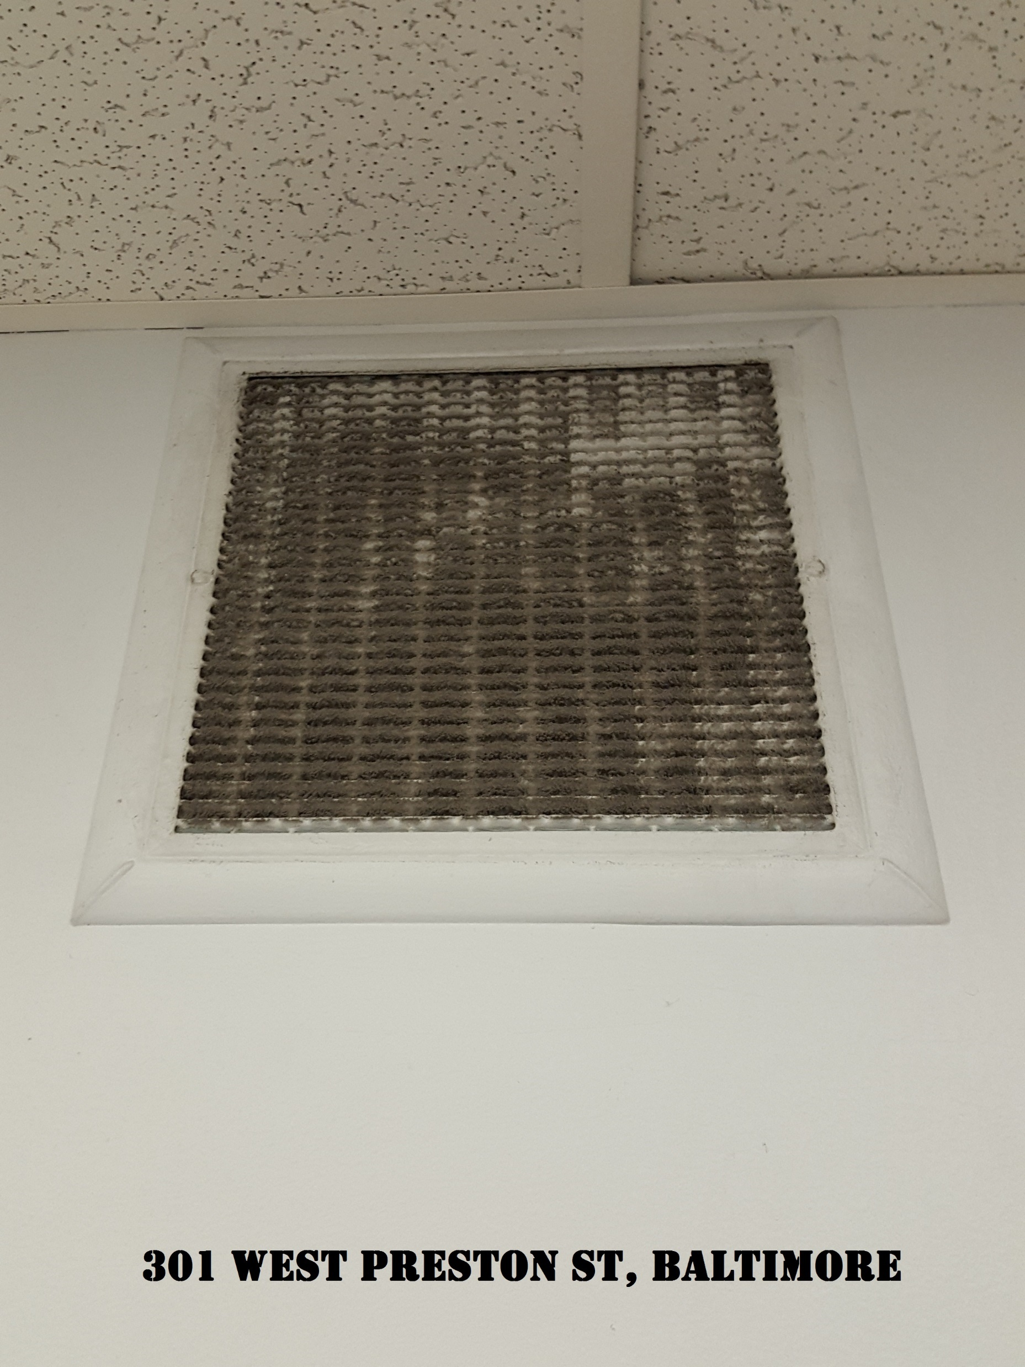
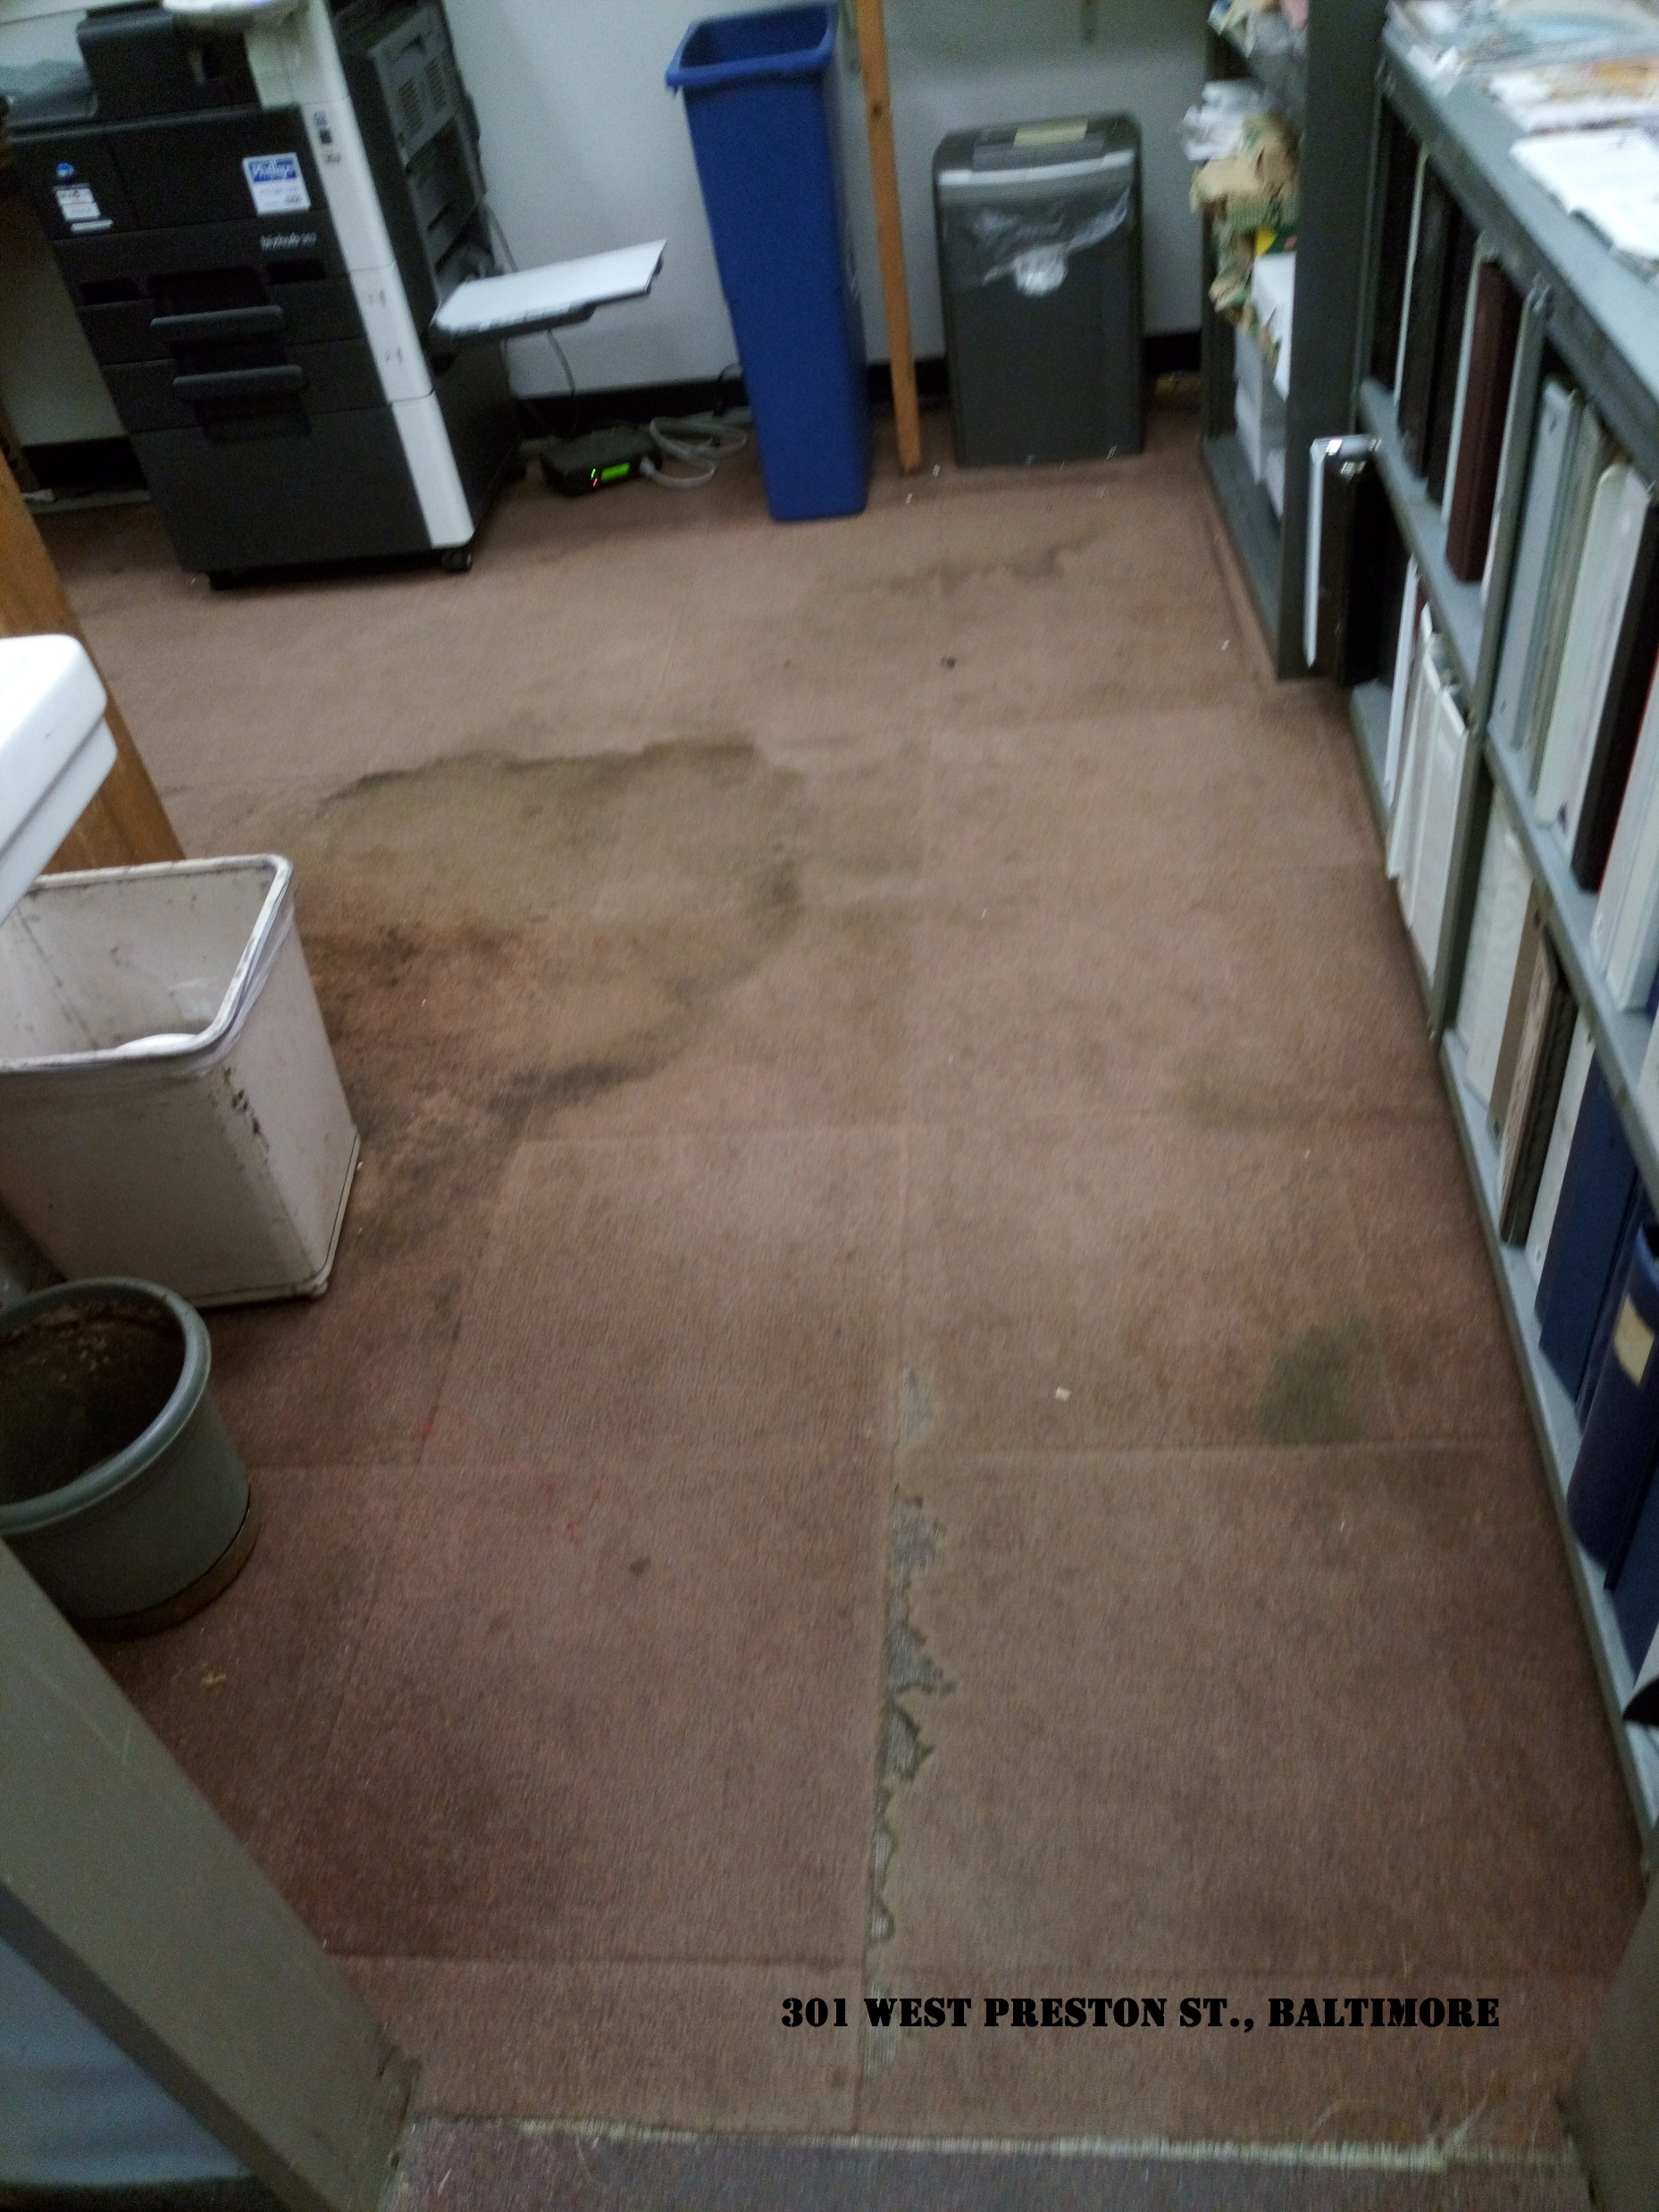
State Employee Indoor Air Quality Survey Results
85% of surveyed employees currently have an illness, symptoms or discomfort that are attributed to conditions in their office or building.
Employees reported experiencing the following symptoms more than once a week:
Dry Skin/Skin Irritation - 68%
Eye Irritation - 65%
Headache – 47%
Fatigue – 54%
Drowsiness – 48%
Sinus Congestion/Infection – 63%
Throat Irritation – 43%
Runny Nose -50%
Chest Tightness/Wheezing - 33%
Allergies - 73%
Difficulty breathing - 26%
Notes:
During the legislative session, MPEC sent out an IAQ survey to members. Members completed the survey and also submitted photos of visible health hazards in their work places.

Slide 3
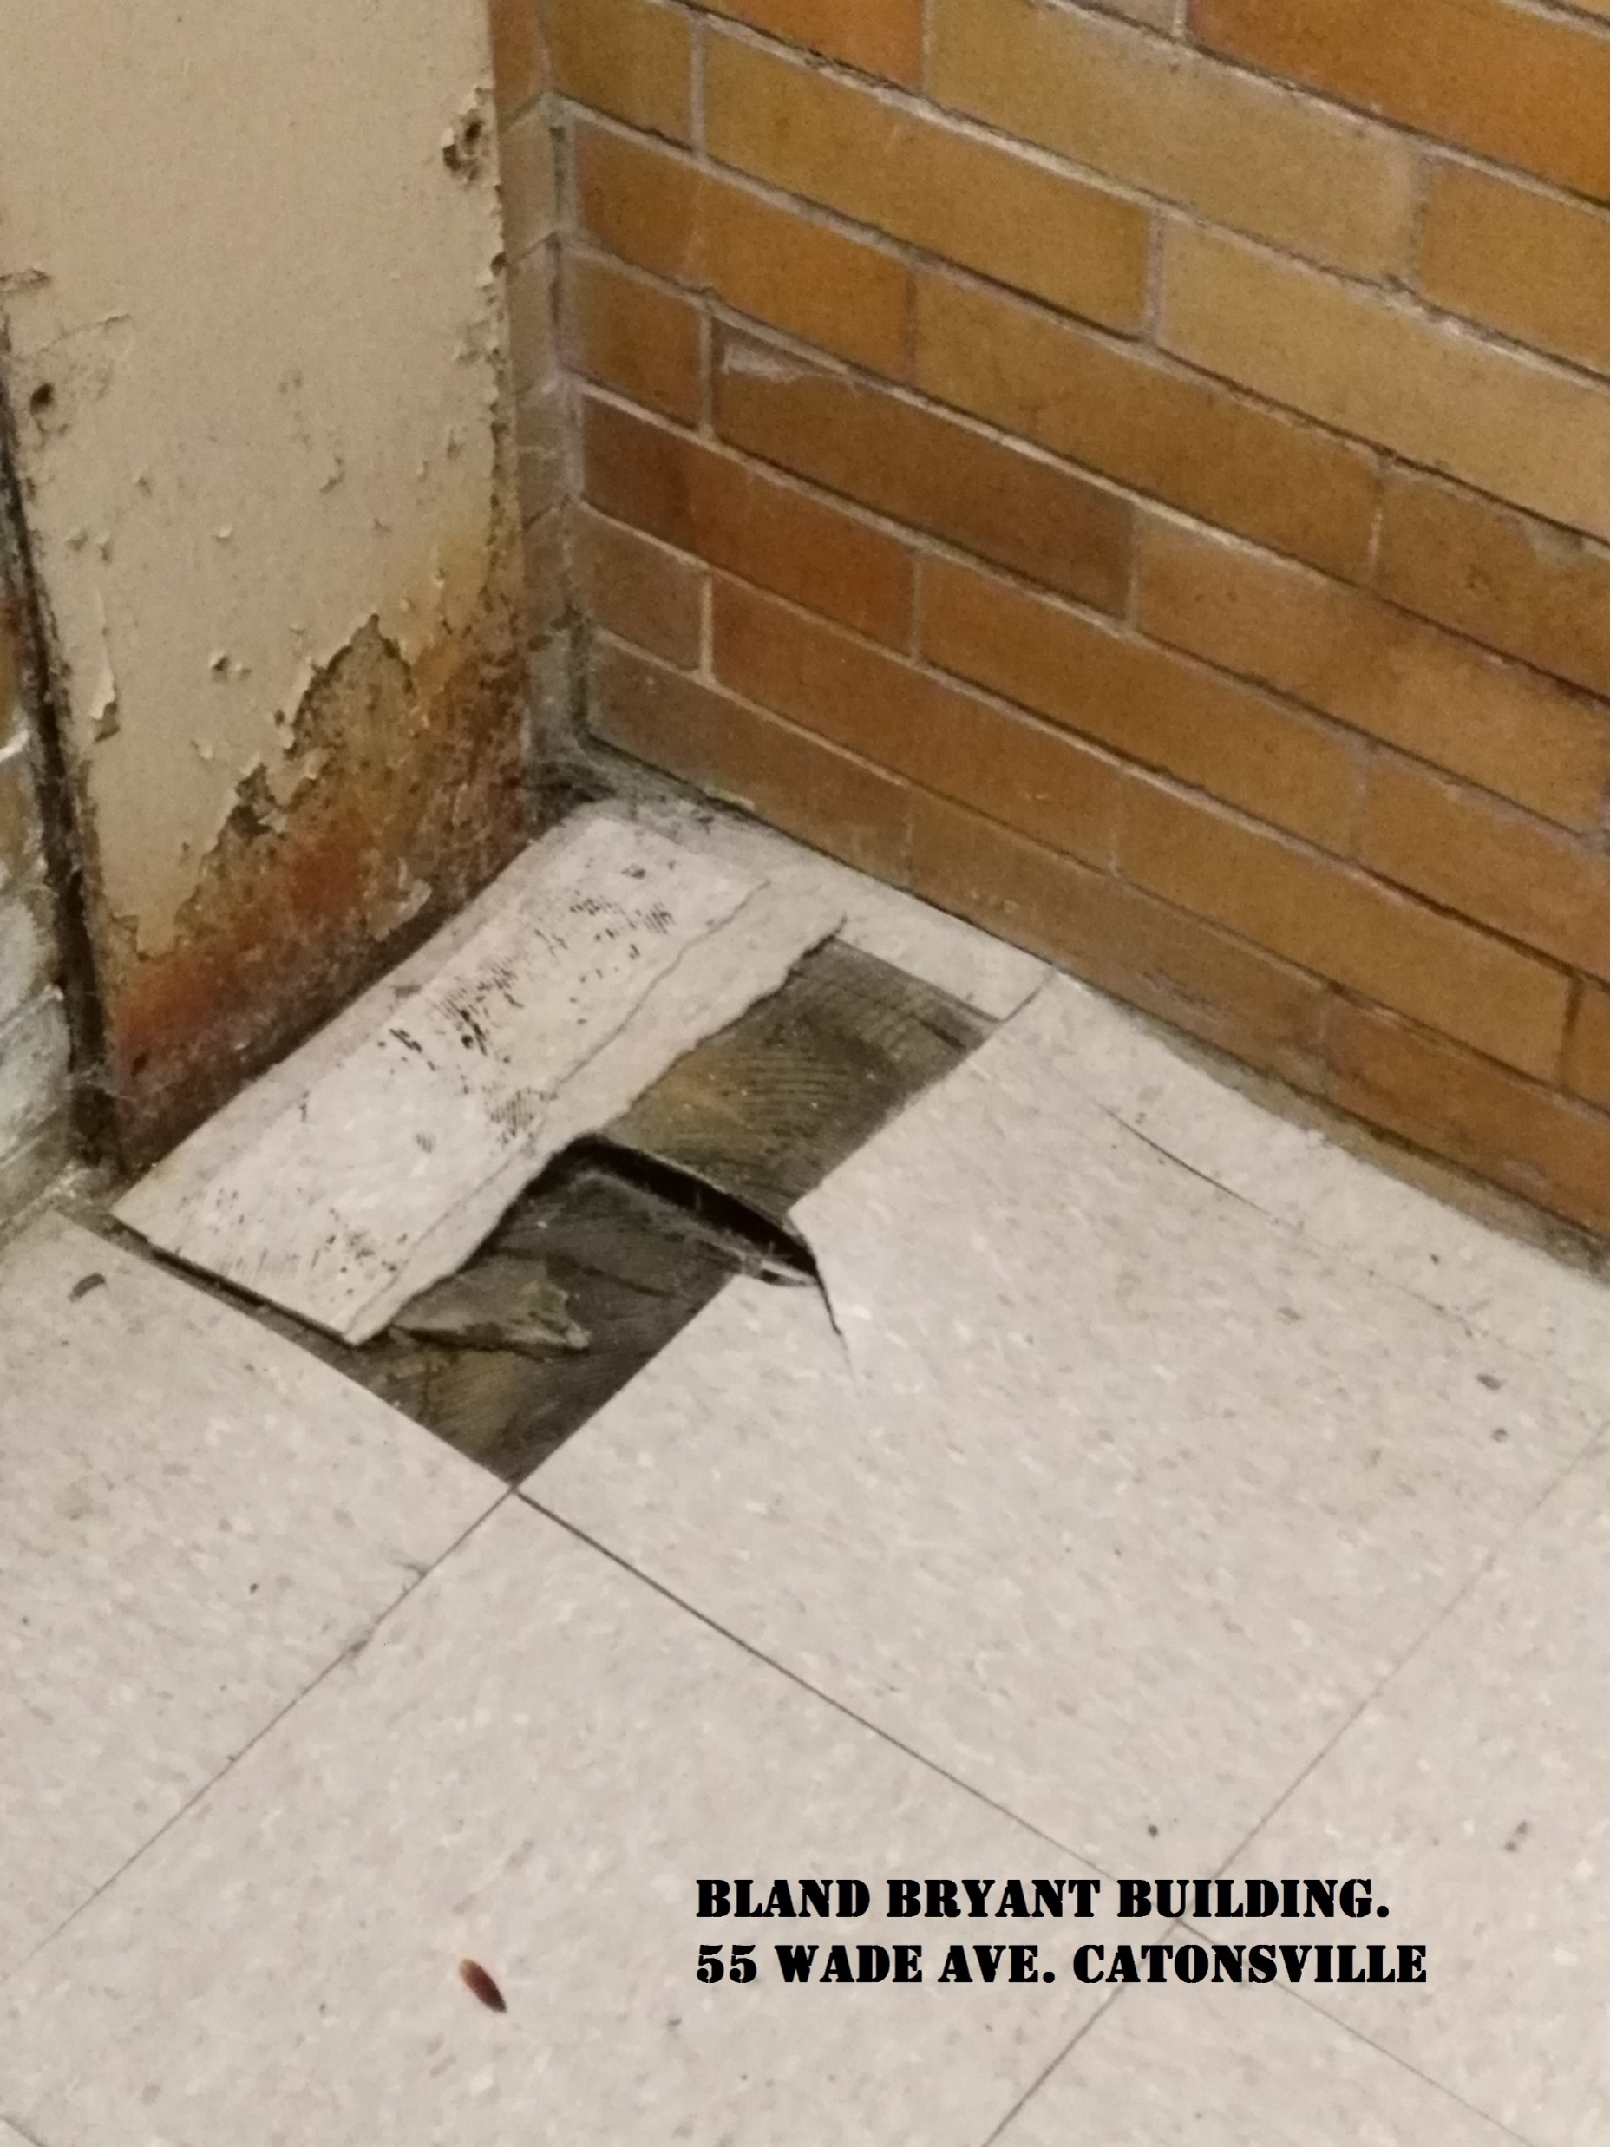
State Employee Indoor Air Quality Survey Results
Of the employees who experience symptoms while at work, 42% of employees reported that their symptoms last less than one hour after leaving their building. 40% reported their symptoms last 1-12 hours after leaving work.
Employees reported being diagnosed with the following since beginning work at their present facility:
Asthma – 11%
Chronic Bronchitis – 24%
Chronic Sinusitis or Sinus Infection – 44%
Allergies – 65%
Other illness you associate with your workplace – 19%
24% reported visible mold growth in their office or workspace.
46% reported evidence of water leaks in their office or workspace.

Slide 4
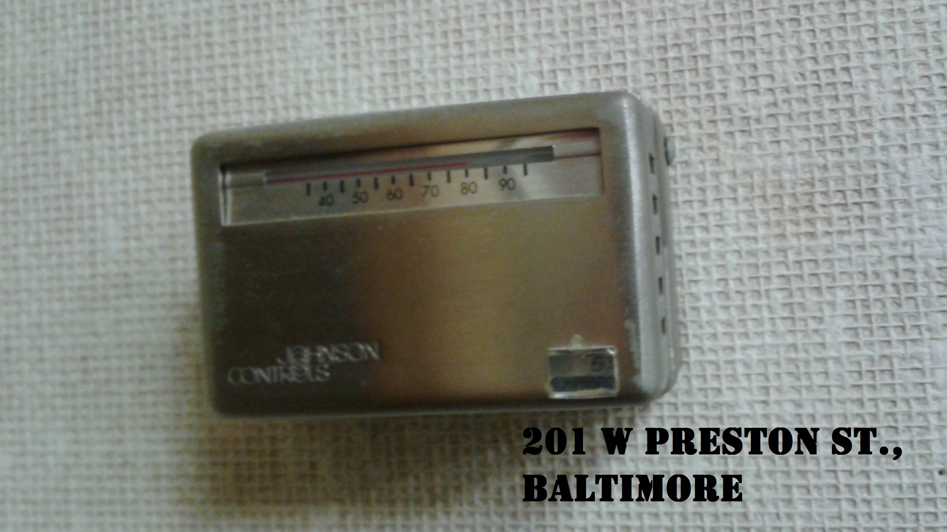
State Employee Indoor Air Quality Survey Results
Employees expressed experiencing the following discomforts in their work place more than once a week:
Room is too hot – 52%
Room is too cold – 51%
Stuffy air – 71%
Air is too moist – 11%
Air is too dusty – 65%
Noticeable odors – 43%
36% of employees surveyed reported renovation work had been done in their workspace over the last year.
Of that 36%, 70% reported that proper safety procedures where not taken to protect employees working in the construction area.

Slide 5
New Jersey Air Quality Standard At A Glace
Temperature/Humidity/General Air Quality
Temperature : 68-76 degrees Fahrenheit in the Winter
72.5-80 degrees Fahrenheit in the Summer
Humidity : 30%-60%
Air must circulate to reach occupants
Filtered or fresh air
Control of drafts

Slide 6
New Jersey Air Quality Standard At A Glace
Control of Chemicals and Biological Pollutants
Elimination of odors
No recirculation of smoky air in non-smoking areas
Isolation of construction/renovation areas; No reoccupancy until odors dissipate
Replace or disinfect moldy, mildewed items
Preventive Maintenance of Ventilation System
Preventative maintenance of HVAC system required
Maintenance records available to union reps and enforcing agencies

Slide 7
New Jersey Indoor Air Quality Standard At A Glace
Complaint and Enforcement Procedures
File initial complaint with employer
DCA (Dept. of Community Affairs) investigates building-related complaints
DCA issues penalties for building related complaints
DOH (Dept. of Health) investigates health-related complaints
DOL (Dept. of Labor) issues penalties for health-related complaints
Notes:
New Jersey Department of Community Affairs (DCA) is a State agency created to provide administrative guidance, financial support and technical assistance to local governments, community development organizations, businesses and individuals.

Slide 8
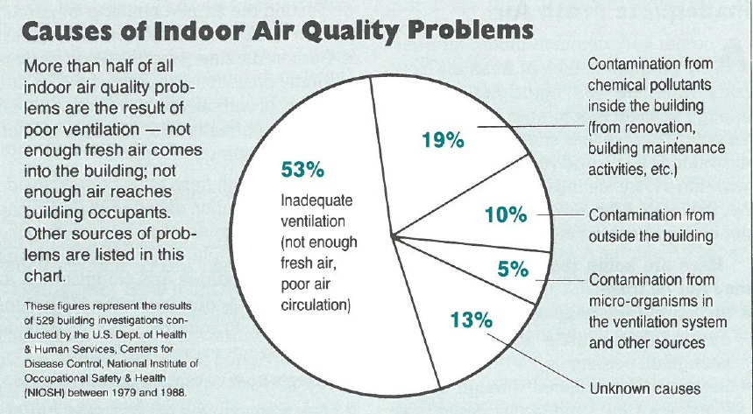
Common Indoor Air Quality Problems
Temperature & Humidity
Inadequate Air Circulation
Inadequate Fresh Air
Contaminated Air
Sick Building Syndrome &
Building-Related Illness

Slide 9
Become A Building Detective

Slide 10
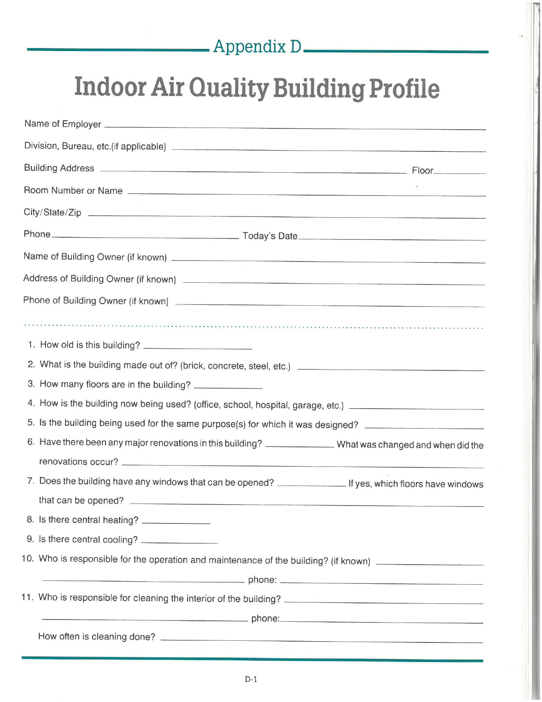
Create a Building Profile

Slide 11
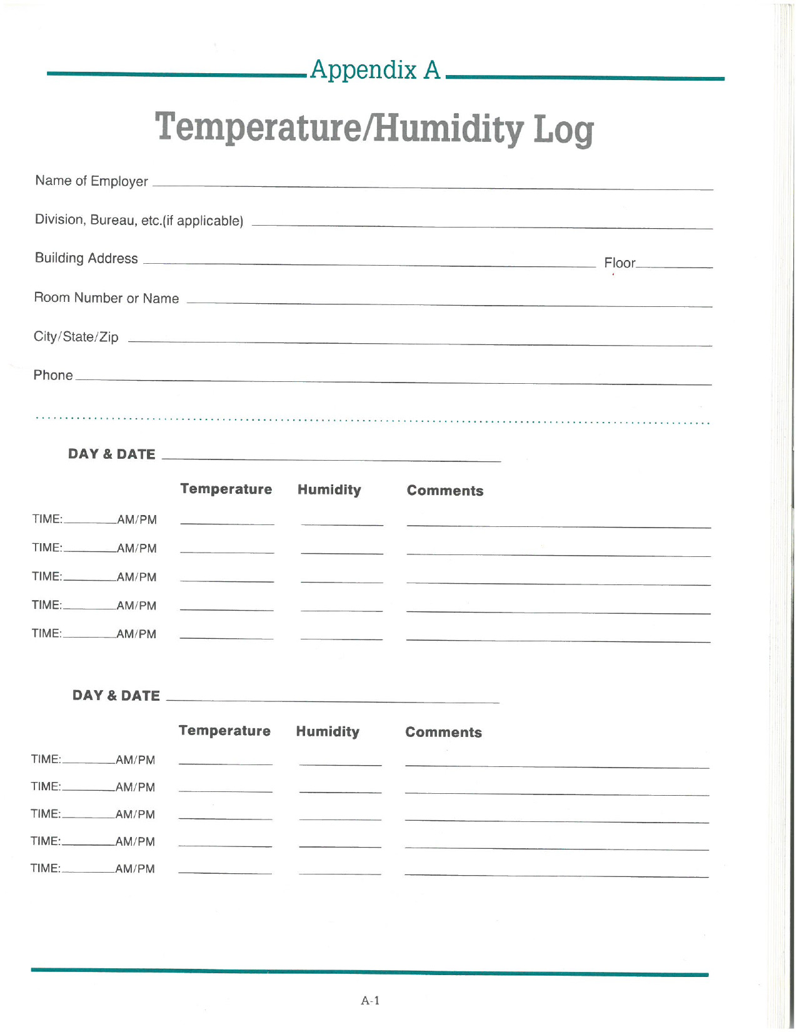
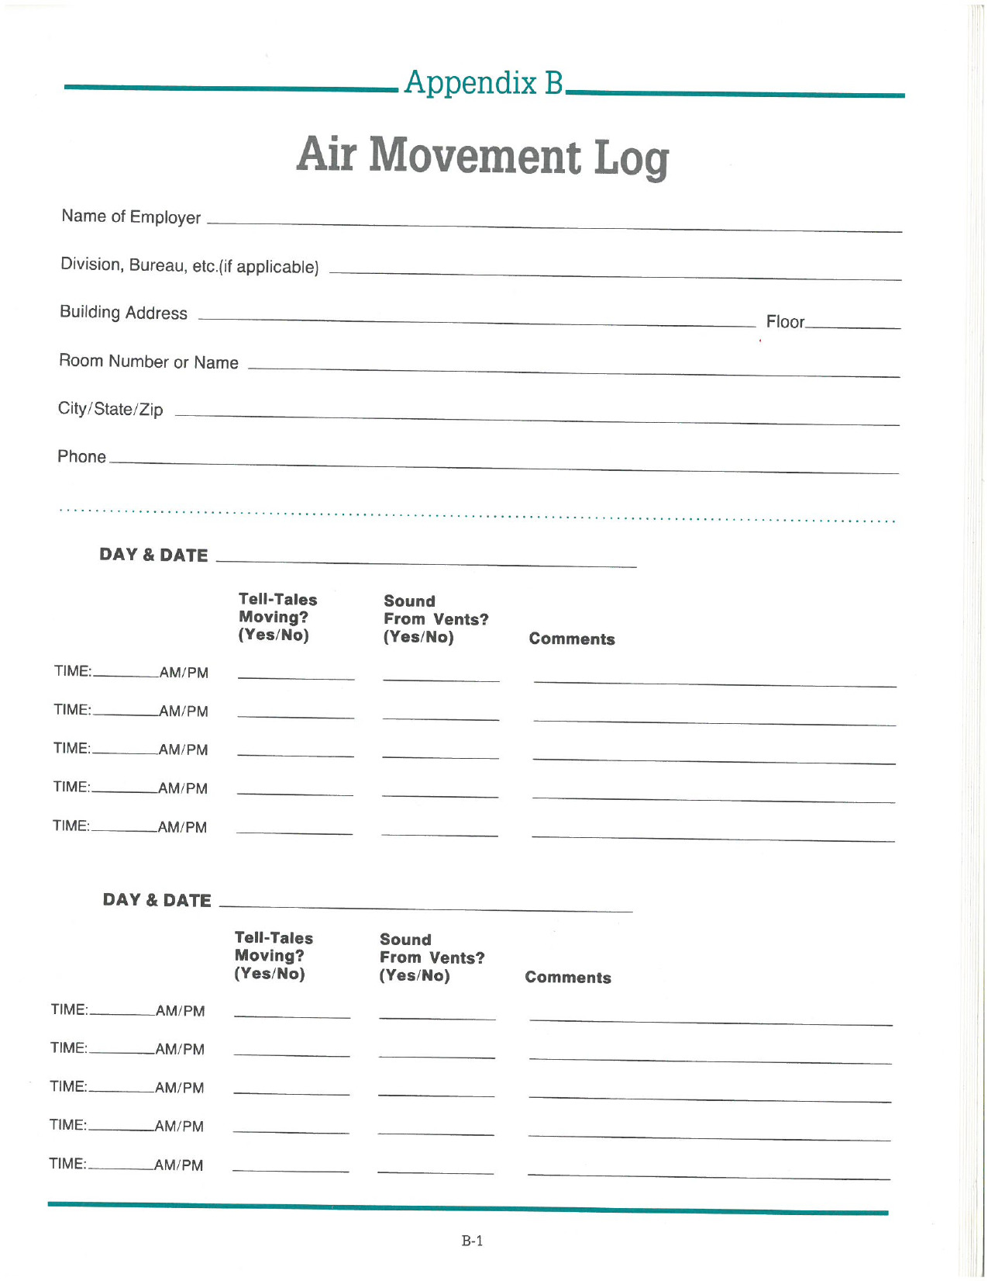
Document IAQ Issues

Slide 12
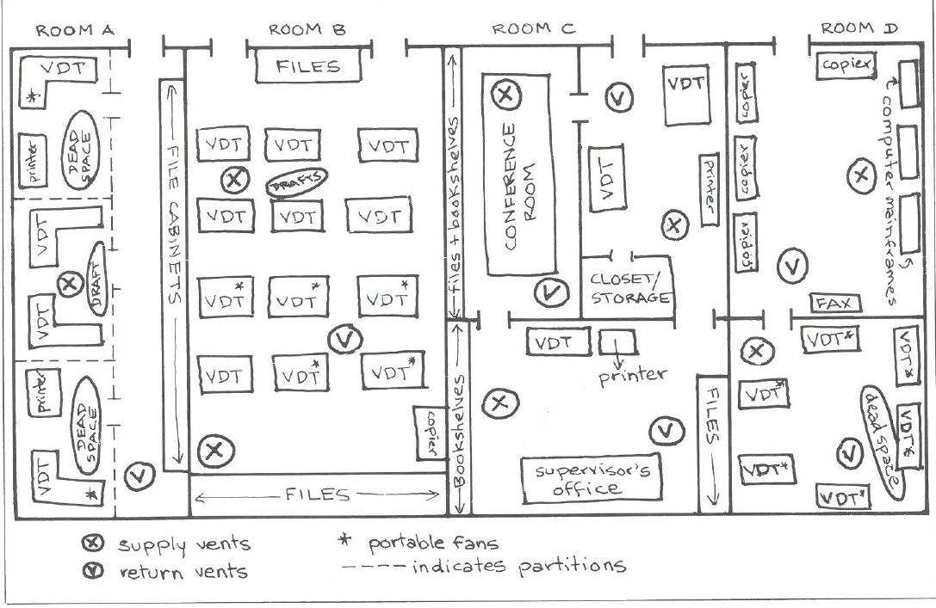
Map Your Workspace and Worksite

Slide 13
Join the Indoor Air Quality Committee!
Notes:
Need as many people to participate as possible.
Would like to have representatives from all over the state.
Gather information, photos
Determine a campaign plan to win an IAQ standard.
Create a joint committee with AFSCME.
Baltimore City Schools, county school are working on improving IAQ.
We need to form a MPEC committee so that we can form a coalition with other public employees that are working on this issue as well.

